Slide 1
Section 5. 4 Solving and Graphing Radicals Functions
© Copyright all rights reserved to Homework depot: www.BCMath.ca

Slide 2
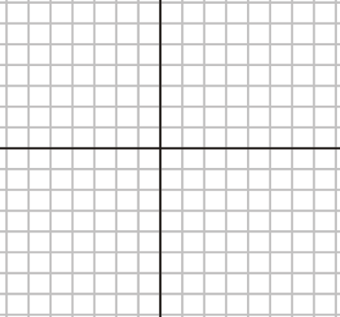
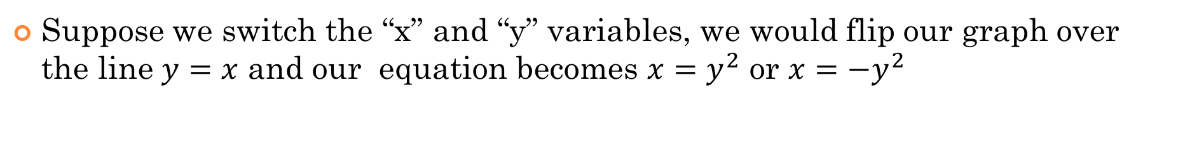
Review: parabolas and Inverse Functions
The graph of $y=x^{2}$ is a parabola that opens up:
The graph of $y={−x}^{2}$ is a parabola that opens down:
Suppose we switch the “x” and “y” variables, we would flip our graph over the line $y=x$ and our equation becomes $x=y^{2}$ or $x={−y}^{2}$

Slide 3
I)Understanding Root Functions:
A root function is the inverse of a quadratic function [parabola]
The top side of the root function is positive
Bottom side of the root function is negative
The top and bottom are two Separate functions
Quadratic Function:
Inverse: Switch “x” and “y”
Square Root Both Sides
y
6
Square Root of a square becomes
an absolute value function
4
2
The top side of the root function
x
-2
0
2
4
6
8
-2
-4
The bottom side of the root function
-6

Slide 4
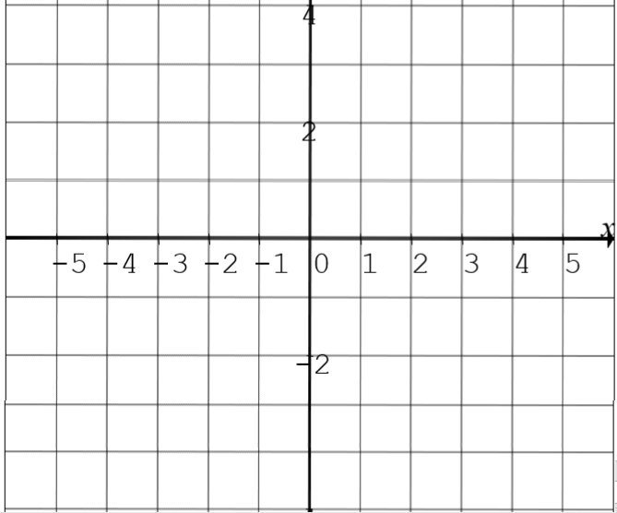
Radical Functions and General Directions:
In this section, we will look at how a radical function is affected graphically when certain transformations are applied to it
Let’s begin by looking at the general direction of a radical function when negative signs are applied:
Radical Opens UP and towards the RIGHT!
Radical Opens DOWN and towards the RIGHT!
Radical Opens UP and towards the LEFT!
Radical Opens DOWN and towards the LEFT!
y
y
4
4
2
2
x
x
-5
-4
-3
-2
-1
0
1
2
3
4
5
-5
-4
-3
-2
-1
0
1
2
3
4
5
-2
-2

Slide 5
II) Where does the Radical Function Begin?
Since you can not square root a negative, use the equation inside the square root to determine:
where the graph starts [Domain]
Which direction it will point (LEFT or RIGHT)
y
y
4
4
2
2
x
x
-5
-4
-3
-2
-1
0
1
2
3
4
5
-2
-1
0
1
2
3
4
5
6
7
8
9
-2
-2

Slide 6
Ex: Indicate which way the radical functions opens (UP/DOWN/LEFT/RIGHT) and then Graph it on the grid provided:
y
y
4
4
2
2
x
x
-5
-4
-3
-2
-1
0
1
2
3
4
5
-2
-1
0
1
2
3
4
5
6
7
8
9
-2
-2

Slide 7
III) Steps for Solving Radical equations
When solving an equation with a radical function,
Isolate the radical
Then square both sides to eliminate the radical
Then solve it algebraically by expanding or factoring
Check if the answer is extraneous, plug it back in to the original equation
If both sides are equal, then the answer is correct
If both sides are not equal, then the answer you have is called an “extraneous root”
You are not required to graph a radical function, but the graphs are provided as a supplement

Slide 8
Isolate the radical
Square both sides to eliminate the ‘square root’
Solve for “x”
Check for “extraneous roots” by plugging it back in
Point of Intersection
“Solution” at x=8.5
y
y
4
4
2
2
x
x
-1
0
1
2
3
4
5
6
7
8
9
10
-1
0
1
2
3
4
5
6
7
8
9
10
-2
-2
Both sides are equal when x=8.5
© Copyright all rights reserved to Homework depot: www.BCMath.ca

Slide 9
Practice: Solve
FOIL
FACTOR
y
The ‘Extraneous Root’ is at the intersection on the bottom side of the parabola.
y
6
Check Both Answers
6
4
Actual Root
It is a root that does not ‘satisfy’
the original equation.
2
4
x
-2
0
2
4
6
8
2
An “Extraneous Root” is not an actual answer….
-2
x
-4
-2
0
2
4
6
8
10
12
14
Extraneous Root!!
The solution is x=5
-6
Extraneous
Root
-2

Slide 10
Ex: Solve
n = 2 is an
Extraneous root.
Therefore, n = 9 is the solution.

Slide 11
What is an Extraneous Root?
An extraneous root is an answer that you get when you solve algebraically but does not make both sides of the equal when you plug it back in
Therefore, an extraneous root is not an answer
You get extraneous roots when solving radical functions b/c “squaring” both sides give you solutions “above” and “below” the x-axis
Since your radical function is above the X-axis, any intersections below the X-axis would be an extraneous point
y
8
6
4
There’s only ONE answer!!
2
x
-4
-2
0
2
4
6
8
10
Solve algebraically will give you both these two answers. However, the bottom point is an “extraneous root” because it’s not an answer (not an actual intersection point)
-2
-4
EXTRANEOUS! NOT AN ANSWER

Slide 12
How TO “DETECT” Extraneous Roots!
One of the main things you need to remember is that a radical above the axis can only be equal to a POSITIVE value
CASE 1: Radicals with a Negative Constant:
This is a positive radical, so it must be equal to a positive value
You have a negative constant on the right. A positive value can not be equal to a negative value
This means you will get an extraneous root and there are NO SOLUTIONS!!
CASE 2: Radicals with a linear function
The radical MUST be positive
Plug your answers here, if it is positive → answer is valid if it is negative → answer is extraneous!
Suppose you solve this equation and got two answers: $−1.6457 and 3.6457$

Slide 13
Practice: Given the following equations, which ones have an extraneous root?
The radical is equal to a negative constant. There are NO solutions. There is an extraneous root
There is a solution.
The radical is equal to a negative constant. There are NO solutions. There is an extraneous root
There is a solution.

Slide 14
Cases with No Solution!
If there are no valid intersection points between the two sides of an equation, then there are no solutions!
Learn to sketch a general graph of the radical function
Ie: Opens UP/Down ? LEFT/RIGHT??? Where it begins?
OPENS UP
Straight line
OPENS UP
Straight line
OPENS Right start at -3
M=1 b=8
OPENS left start at 2
M=1 b=-4
y
y
8
8
6
6
4
4
2
2
x
x
-4
-2
0
2
4
6
8
10
-4
-2
0
2
4
6
8
10
By drawing a rough sketch, you can see that there are no intersections NO SOLUTIONS!!
-2
-2
-4
-4

Slide 15
iv) Cases with No Solution
Isolate the root, one side with be a radical function, the other side a linear function
If the other side is a negative constant, then there will be no solution (No intersection)
If there are no intersections graphically, then there are no solutions!
y
y
This system has no solutions!!
4
8
2
This system has no solutions!!
6
x
4
-4
-2
0
2
4
2
x
-2
-4
-2
0
2
4
6
8
10
-2
-4
-4

Slide 16
Ex: Which of the following equations will have an extraneous root?
y
y
y
8
8
8
6
6
6
4
4
4
2
2
2
x
x
x
-4
-2
0
2
4
6
8
10
-4
-2
0
2
4
6
8
10
-4
-2
0
2
4
6
8
10
-2
-2
-2
-4
-4
-4
The line doesn’t even intersect the bottom half. So no extraneous root!
The line doesn’t even intersect the bottom half. So no extraneous root!
The line intersect the bottom half. So there is an extraneous root!
y
y
8
8
6
6
The line intersect the bottom half. So there is an extraneous root!
The line doesn’t even intersect the bottom half. So no extraneous root!
4
4
2
2
x
x
-4
-2
0
2
4
6
8
10
-4
-2
0
2
4
6
8
10
-2
-2
-4
-4

Slide 17
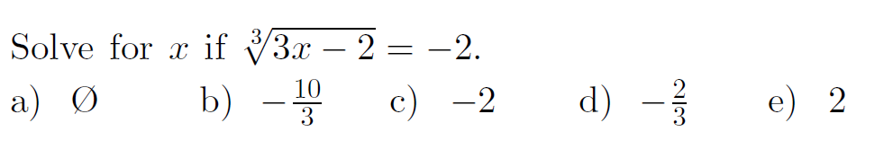
Q1: Solve the following equation:
Q3: Expand the following

Slide 18
Solve the following equation:

Slide 20
Practice: Expand the following
YOU NEED TO FOIL!!!

Slide 21
V) What if there are TWO Radicals??
1. Move one of the radicals to the other side
2. FOIL both sides
3. Make sure you know how to expand each side correctly!!
5. Square both sides again
4. Simplify and solve for “x”
6. Go and check your solution

Slide 22
Check:
So x = 6 is extraneous
Therefore, x = 1 is the only solution.

Slide 23
Extraneous!

Slide 24
Solve the equation:
Extraneous!

Slide 25
Check:

Slide 26
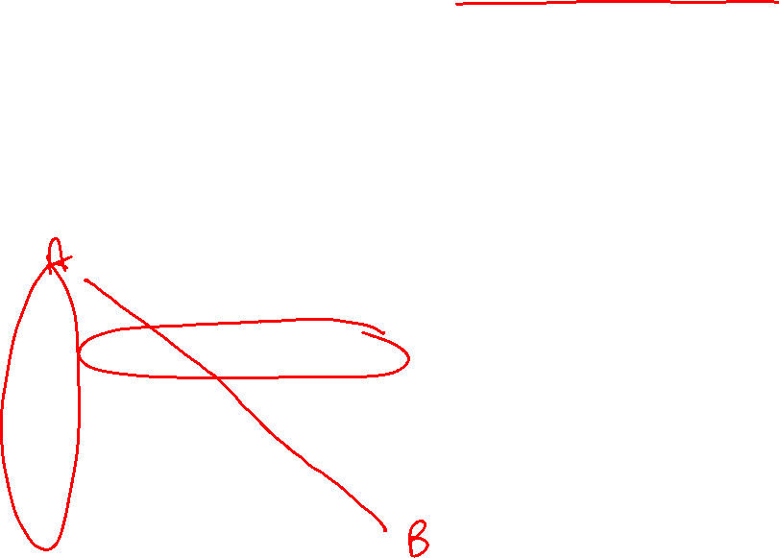
Find the minimum value of:
MS WU’s Chinese Method: Turning Radicals into Right Triangles
Complete the square inside each radical and create a right triangle inside
Now treat each radical as the expression for the hypotenuse
Key Step!!
Now, the distance between the corner is the sum of the hypotenuse.
The minimum sum of the two sides is the shortest distance!!

Slide 28
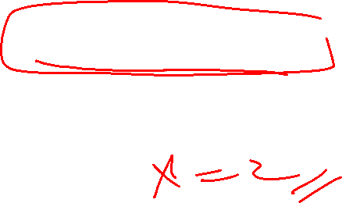
Evaluate:
Rewrite the equation to make it easier to solve:
Our equation now becomes:
Our cubic equation can be solved by guess and check

